Slide 1


Digital Freelancer:
Managing Freelancing Projects
Project: Working with a Mock Client

Slide 2
Part 1
Project Listing

Slide 3
Sample Project Listing #2:
Digital Marketing
Email Marketer for Annual Fundraising Event.
Posted 2 days ago
Hourly: $30.00 - $40.00.
Project Time: 1 month, 10 - 15 hours a week.
Project Description:
We are looking for someone to create a drip email campaign to help us sell tickets for our annual fundraising event for our non-profit. This would require audience segmentation, custom email creation, and call-to-action development. We are to reach our goal of 700 tickets sold. We haven’t decided on the best tool to do this yet and would be open to your recommendations. Serious inquiries only.

Slide 4
Part 2
Expression of Interest

Slide 5
Expression of Interest (Provided)
Which Sample Project Listing did you select to respond to?
Answer:
Email Marketer for Annual Fundraising Event.
Expression of Interest:
Dear, Team
I am happy to collaborate with you on our annual fundraising event as an Email Marketer. And do create an email drip campaign to sell tickets.
I have three and a half years of experience as an email marketer and 33 clients in Egypt and the USA.Your requirement :
audience segmentation
create a drip email campaign
custom email creation
best tools to do this
reach to 700 tickets sold
call-to-action development

Slide 6
I’m able to do all the above as follows:
audience segmentation < I will segment the audience into 3 classes (A, B, and C) the social level
I will create a custom email creation (contact@samaa.website) to be more professional
I will send an email message with a strong call-to-action to encourage them to buy the ticket till reach 700 tickets sold
I will use the best tools to do this such as :
HubSpot Email Marketing, Sender, SendPulse or MailChimp
5. I will create an attractive drip email campaign in one month 10-15/week the total cost is between range 1200$-2400$ which means 30$-40$/hrs

Slide 7
My skills :
I know how to work with various email marketing applications. ...
Improving Deliverability. ...
Understanding Segmentation and Personalization. ...
Knowledge of Compliances. ...
Analytical Mindset.
My offer is :
Less cost per hrs. I will complete your project at a cost 30$/hrs.
Complete your project maximum of 20 days
3. Save your budget that it will be after my offer in rage
900$ -1000$ instead of 1200$-2400$
I hope my offer is suitable for you & confirm it and contact me very soon
Best regards,
Raghda Helmy

Slide 8
Part 3
Project Management Process

Slide 9
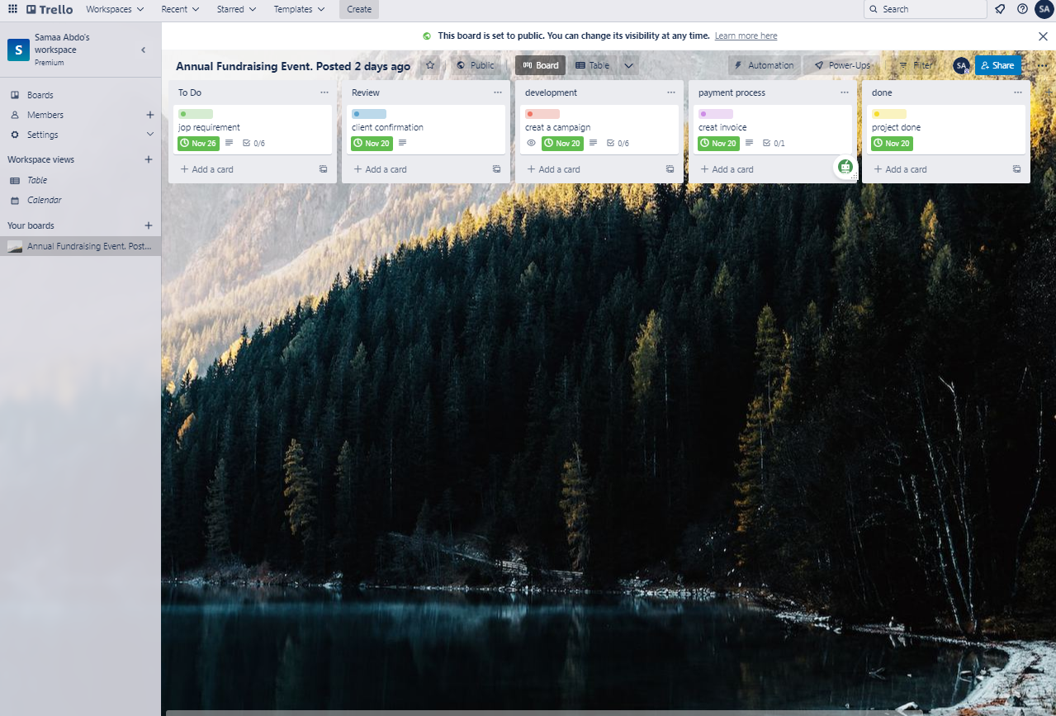
Trello Board
Please include the following information for your Trello board:
https://bit.ly/3Nzx8fw
A link to your public Trello board should be provided here:
[Link to Trello board]
Include a screenshot of the board below:
Paste screenshot here

Slide 10
Part 4
Invoice and Payment Options

Slide 11
[sama alsayed abdo ]
[Egypt, Alexandria]
Invoice
Recipient:
[team]
[USA]
Invoice #: [65599]
Date issued: [6/11/2022]
Date due: [26/11/2022]
Services Rendered (Continue on next page)
Service | Description of Work Done | Hours Spent | Amount Per Hour | Total
Understand the goal of email campaign | Understand the goal of your email campaign | 2 hrs. | 30$ | 2*30$=60$
Define target audience | Define the target audience who interest with this type of emails | 5 hrs. | 30$ | 5*30$=150$
Choose email campaign type | Choose an email campaign type depending on the goal and target audience. | 5 hrs. | 30$ | 5*30$=150$
Segment audiences | Segment audiences to classes (A,B,C) | 5 hrs. | 30$ | 5*30$=150$

Slide 12
[samaa alsayed abdo ] Egypt Alexandria
Invoice
Services Rendered (continued)
Service | Description of Work Done | Hours Spent | Amount Per Hour | Total
Event-Triggered Automation | Create automated interactions with event-triggered campaigns over the right channel –based on customer actions and their behavior. | 5 hrs. | 30$ | 5*30$=150$
A/B Test Campaigns | Tweak and tune your campaigns with A/B testing to see what works best and the perfect channels to use. | 5 hrs. | 30$ | 5*30$=150$
Campaign Efficiency Results | Monitor the effectiveness of your communication flow at in real time and set up goals to track key performance indicators. | 5 hrs. | 30$ | 5*30$=150$
Total Payment Due: [960$]
Payment Options: By My PayPal , PayMob , Payoneer
at e-mail address (samaaabdo941@gmail.com )

